Slide 1
Welcome
to
C Programming
LIKE SHARE SUBSCRIBE
www.youtube.com/c/sundeepsaradhi

Slide 2
Introduction to C
Compiler and Interpreter
Execution of C Program
Structure of C Program
Identifiers
Keywords
Basic Data Types
Constants
Variables
Input – Output Statements
Operators
Operator Precedence
Order of Evaluation
Control Structures
Arrays ( Numerical Arrays & Character Arrays )
Functions , Storage Classes
Pointers , Dynamic Memory Allocation
Derived Types ( Structures & Unions )
Files
www.youtube.com/c/sundeepsaradhi

Slide 3
Introduction to C
C programming language was developed in 1972 by Dennis Ritchie at bell laboratories of AT&T (American Telephone & Telegraph), located in the U.S.A.
It was developed to overcome the problems of previous languages such as B, BCPL, etc.
Initially, C language was developed to be used in UNIX operating system. It inherits many features of previous languages such as B and BCPL.
Advantages
C language is a building block for many other currently known languages.
C language is a structured programming language. This makes user to think of a problem in terms of function modules or blocks. Collection of these modules makes a complete program. This modular structure makes program debugging, testing and maintenance easier.

Slide 4
Compiler & Interpreter
COMPILER
Source Code
Compiler
Machine Code
Output
INTERPRETER
Source Code
Interpreter
Output
Compiler
Virtual Machine
www.youtube.com/c/sundeepsaradhi

Slide 5
Execution of C Program
Write the program in editor / compiler
Save the file with .c Extension
Compile the program
Make the program Error free ( syntax errors )
Run the Program and get the output
www.youtube.com/c/sundeepsaradhi

Slide 6
Structure of C Program
Documentation Section
Link Section
Definition Section
Global Declaration Section
Main ( ) Function Section
{
Declaration Part
Executable Part
}
Sub Program Section
Function 1
Function 2
- (User-Defined Functions)
-
Function n
www.youtube.com/c/sundeepsaradhi

Slide 7
Identifiers
C Identifier refers to name used to identify user-defined item or entity ( Variable , Constant , function , structure etc.)
Identifier must be unique and they are created to give unique name to a entity or item to identify during the execution of a program.
Identifiers are different from keywords as keywords are predefined and given by the compiler and identifiers are given by the user.
Identifier name should not match with the keywords.
www.youtube.com/c/sundeepsaradhi

Slide 8
Keywords
auto | Double | int | struct
break | else | long | switch
case | enum | register | typedef
char | extern | return | union
continue | for | signed | void
do | if | static | while
default | goto | sizeof | volatile
const | float | short | unsigned
www.youtube.com/c/sundeepsaradhi

Slide 9
Data Types
C Data Types
Primitive
Derived
User Defined
char
int
float
double
void
array
pointer
structure
union
enum
typedef
www.youtube.com/c/sundeepsaradhi

Slide 10
Data Type | Size of Data Type (in Bytes) | Range | Format Specifier
char | 1 | -128 to 127 | %c
int | 2 | -2¹⁵ to 2¹⁵ - 1 | %d
float | 4 | -2³¹ to 2³¹ - 1 | %f
double | 8 | -2⁶³ to 2⁶³ - 1 | %lf
MODIFIERS
unsigned char | 1 | 0 to 255 | %c
unsigned int | 2 | 0 to 2¹⁶ - 1 | %u
short int | 1 | -128 to 127 | %d
unsigned short int | 1 | 0 to 255 | %u
long int | 4 | -2³¹ to 2³¹ – 1 | %ld
unsigned short int | 4 | 0 to 2³² – 1 | %lu
long double | 10 | -2⁷⁹ to 2⁷⁹ - 1 | %Lf

Slide 11
Constants & Variables
Variable Name
A Variable is defined as an alternate name for Memory Location and can have a short name or a more descriptive name.
Rules for Python Variables
A Variable name must start with a letter or the underscore character
A Variable name cannot start with a number
A Variable name can only have alpha-numeric characters and underscores (A-z, 0-9, and _ )
Variable names are case-sensitive. (name, Name and NAME are three different variables.
Variable name should not match with Keywords
www.youtube.com/c/sundeepsaradhi

Slide 12
Input – Output Statements
Input Statement / Function
scanf(“control_specifier”,&variable_name)
Output Statement / Function
printf(“String”)
print(“control_specifiers”,variable_names)
www.youtube.com/c/sundeepsaradhi

Slide 13
Operators
Arithmetic Operators - + , - , * , / , %
Relational Operators - < , > , <= , >= , == , !=
Assignment Operators - = , += , -= , *= , /= , %= , //= etc.,
Bitwise Operators - & , | , ^ , ~ , << , >>
Logical Operators - and , or , not
Increment Operators - ++ , --
Ternary Operator - ? :
www.youtube.com/c/sundeepsaradhi

Slide 14
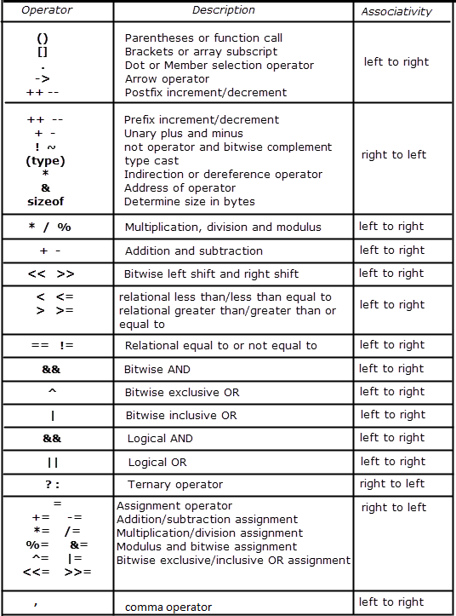
Operator Precedence
1
2
www.youtube.com/c/sundeepsaradhi

Slide 15
Order of Evaluation
a=5 b=6 c=10 d=7 e=2
a + b – c * d / e
a+++b
www.youtube.com/c/sundeepsaradhi

Slide 16
Control Structures

Slide 17
Control Structures
Sequential Execution
Conditional Statements
Iterative Statements
Jumping Statements
if , if else ,
if elif else , nested if,
switch
While , for ,
do - while
break , continue
www.youtube.com/c/sundeepsaradhi

Slide 18
Control Structures
Conditional Statements
if
if – else
Nested If – else
switch
Jumping Statements
continue
break
Goto
C Loops
while
for
do - while

Slide 19
Arrays
( Numerical & Character Arrays)
www.youtube.com/c/sundeepsaradhi

Slide 20
Arrays ( Numerical Arrays)
One Dimensional Arrays
Declaration
Definition
Initialization
Accessing Elements
Storing Elements
Two Dimensional Arrays
Multi-Dimensional Arrays
www.youtube.com/c/sundeepsaradhi

Slide 21
Arrays ( Character Arrays)
Character Arrays ( Strings )
Declaration
Initialization
Reading Strings
Writing Strings
Arithmetic Operations on characters
String Handling Functions
www.youtube.com/c/sundeepsaradhi

Slide 22
Functions
www.youtube.com/c/sundeepsaradhi

Slide 23
Function Declaration
Function Call
Function Definition
Category of Functions
Parameter Passing Techniques
Recursion
Recursion Vs Iteration
Local & Global Variables
Storage Classes
Dynamic Memory Allocation
Command Line Arguments

Slide 24
Pointers
Declaring & Initialization of Pointer Variables
Pointer Expressions
Pointer Arithmetic
Pointers & Arrays
Pointers & Character Strings
Pointer to Pointer
Pre-processor Directives
www.youtube.com/c/sundeepsaradhi

Slide 25
Derived Types ( Structures & Unions )
Structures – Declaring & Initialization
Accessing members of structures
Structures and Functions
Pointer to Structure
Self Referential Structures
Unions
Structures Vs Unions
Typedef
www.youtube.com/c/sundeepsaradhi

Slide 26
Files
What is File ?
Opening a File
Access Modes
Closing File
Writing Data into File
Reading Data from File
File Handling functions
ftell , fseek , rewind
www.youtube.com/c/sundeepsaradhi

Slide 27
For Queries Contact :
Email : askme.selflearning@gmail.com
WhatsApp : 9515140494
Like Share Subscribe
www.youtube.com/c/sundeepsaradhi

